Slide 1
Container Gardening
Sitting Bull College Agriculture Division

Slide 2
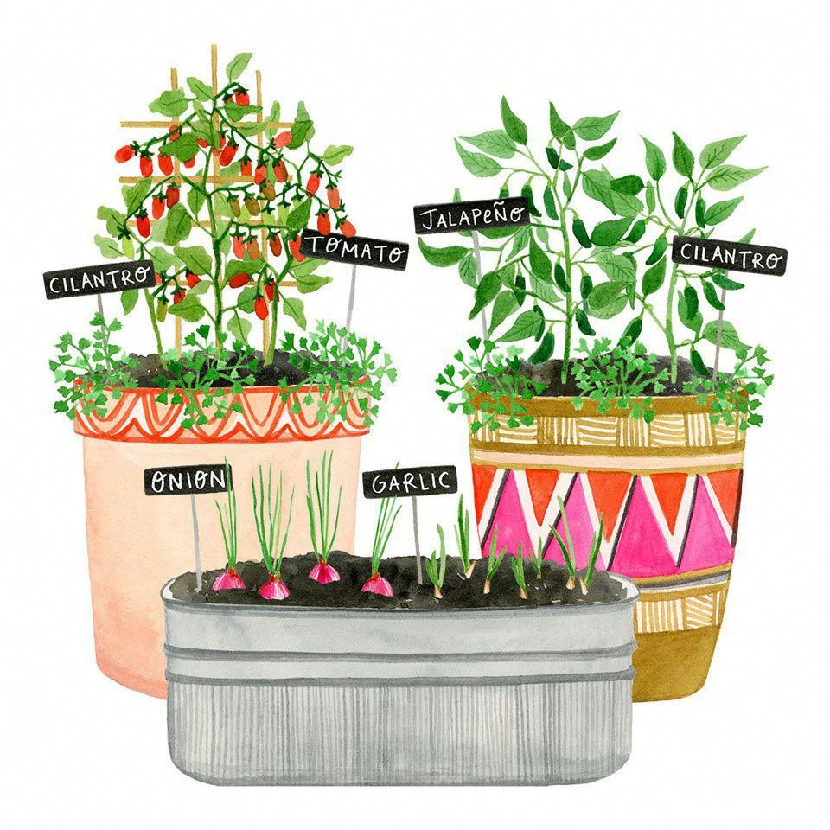
Overview
Sunlight & Temperature
Soil
Water
Fertilizer
Drainage
Container
Plants
Tools
Benefits/Disadvantages

Slide 3
Sunlight and Temperature
Most plants need full sun, in order to grow successfully, which is at least six hours of direct sunlight each day.
The soil should be at least 60° F, as that is what most plants require for a successful growing season.

Slide 4
Estimated Cost
 | $ | $$ | $$$
Organic | $13 (8qts) | $25 (8.5qts) | $30 (8qts)
Inorganic | $9 (25qts) | $16 (25qts) | -

Slide 5
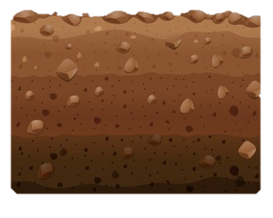
Use high quality potting soil. Using soil straight from the earth could cause the soil to become compact and make water drainage difficult. Using potting soil will ensure that you have soil without soil-borne diseases.
Good Earth Organics “Cloud 9” Potting Mix
Wild Valley Farms “All Natural Intelli-Soil” Potting Mix
Miracle-Gro® Potting Mix
Miracle-Gro® “Moisture Control” Potting Mix
SOIL

Slide 6
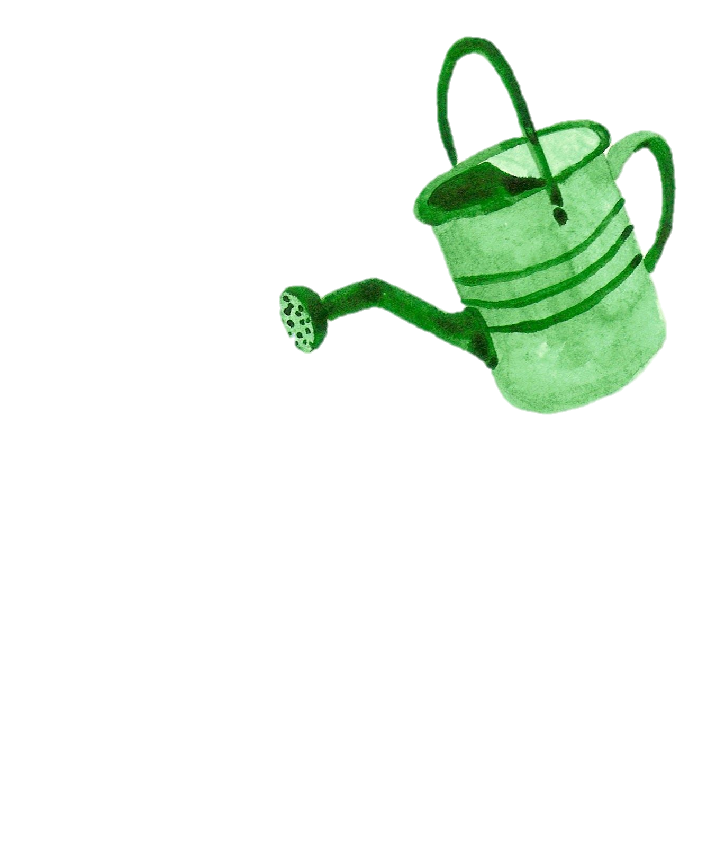
Watering
Soil must be moist, but not soaking wet. To check soil moisture, stick a finger about an inch deep, if it feels dry, add water.
At the height of summer, plants may need to be watered twice a day. Higher temperatures will cause more evaporation and water uptake by plants.

Slide 7
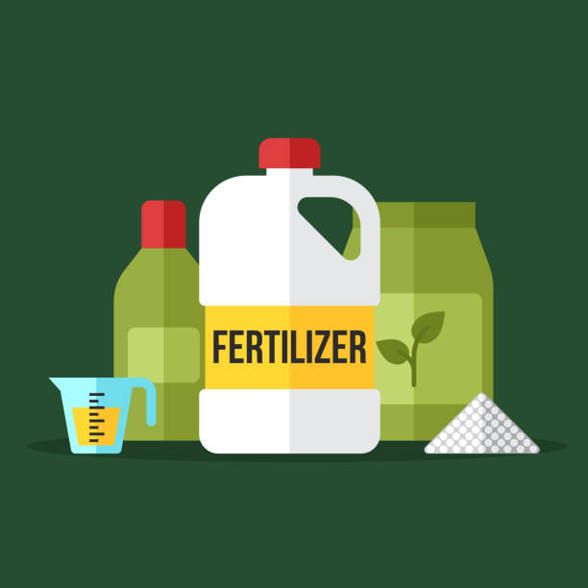
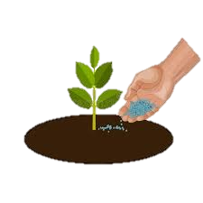
Fertilizer
Potting Soil WITH Fertilizer
Potting Soil WITHOUT Fertilizer
Don’t have to add any fertilizer before planting
After fertilizer is depleted, start adding fertilizer, as needed, throughout growing season.
Add fertilizer before planting
Continue to add fertilizer, as needed, throughout growing season.
*Which ever fertilizer is chosen, it is very important to read the application instructions.

Slide 8
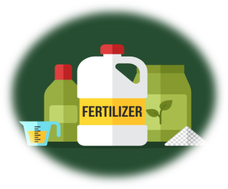
Fertilizer Options
Fertilizers from the Store
Fertilizers from Home
Granular (slow releasing)
Apply every 6-9 months
Water-soluble (fast acting)
Must be applied frequently
Good for container plants/”gardens”
Grass Clippings
Kitchen Scraps (compost)
Coffee Grounds (acidic)
Eggshells (alkaline)
Manure

Slide 10
Estimated Cost
 | $ | $$ | $$$
Granular | $10 (2.5lbs) | $53 (25lbs) | $160 (22lbs)
Water-soluble | $11 (3lbs) | $14 (64fl oz) | $60 (25lbs)

Slide 11
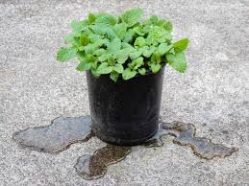
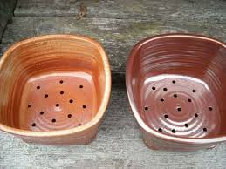
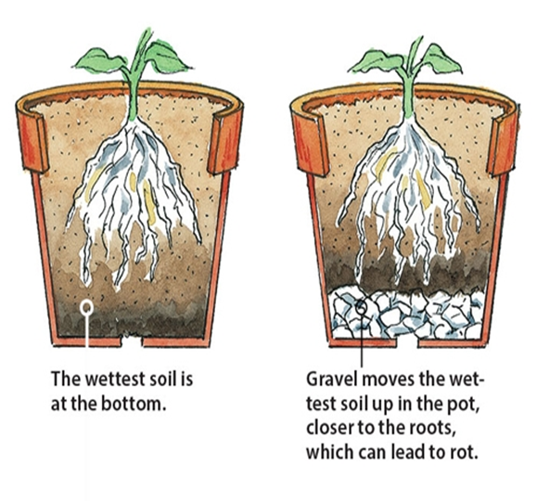
Drainage
Very important for container gardens
There should be one large hoke or several smaller holes at the base of the container
Use a coffee filter or plastic screen to keep soil from falling through the drainage hole
If container is on a hard surface, the hole might plug. Using pot feet or legs can elevate the container allowing for easier drainage.

Slide 12
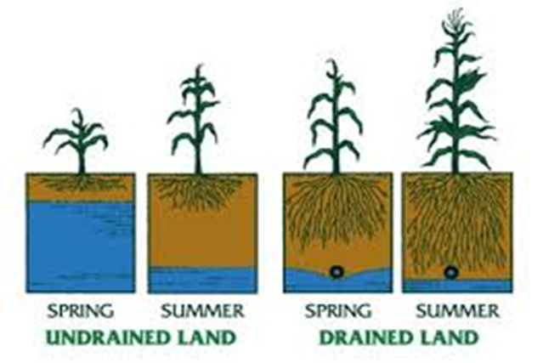
Poor Drainage

Slide 13
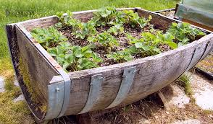
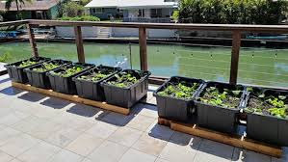
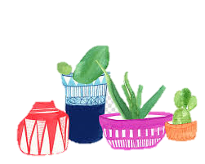
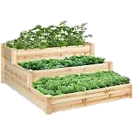
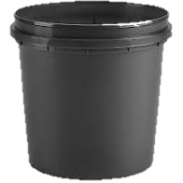
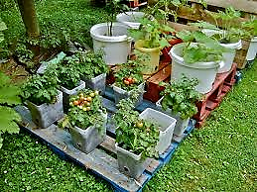
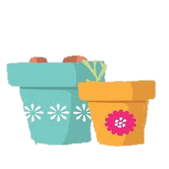
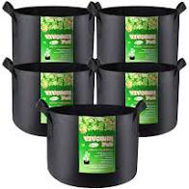
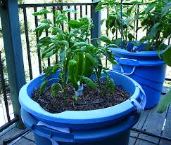
Container
Make sure your container is big enough, made of a safe material, and has good drainage.
Larger containers will be easier to maintain, because it will be able to hold more soil and retain more water.
Container should not be smaller than 12” across.
Doing a container garden is a great way to recycle old bucket, tubs, etc.!

Slide 14
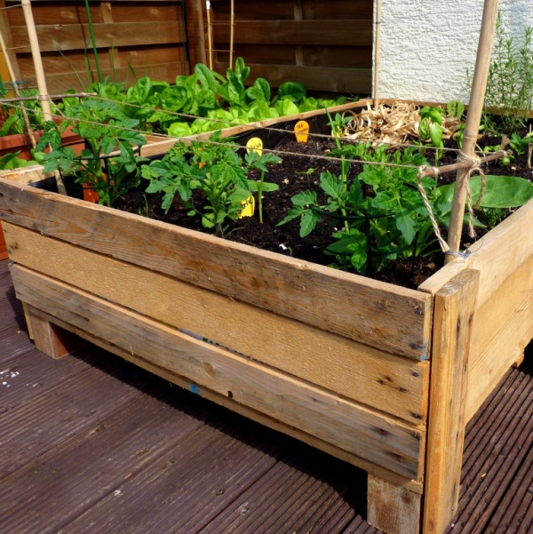
Wooden Containers
Old scrap wood
Old pallets
Tree stump
Old wooden barrel
Pre-made from store

Slide 15
Ceramic Containers
Clay pots allow for easier evaporation through the container. To avoid evaporation, line the pot with plastic lining. Glazed ceramic is also an option for avoiding evaporation.

Slide 16
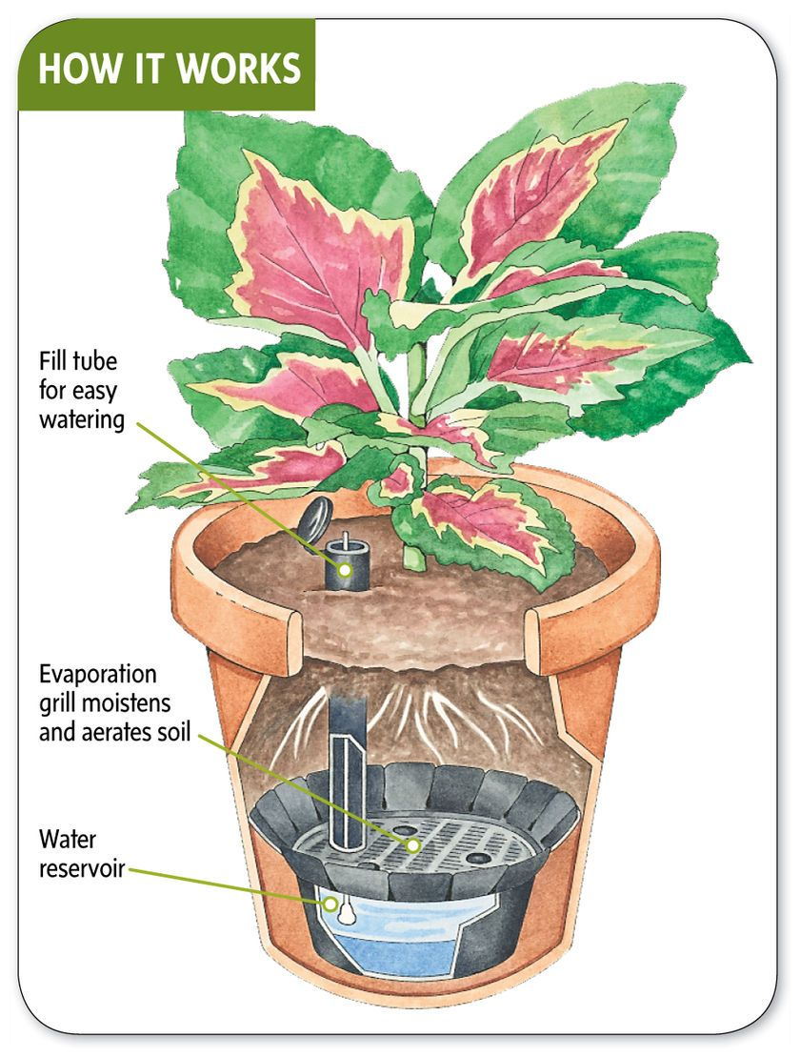
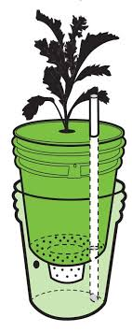
Self-watering

Slide 17
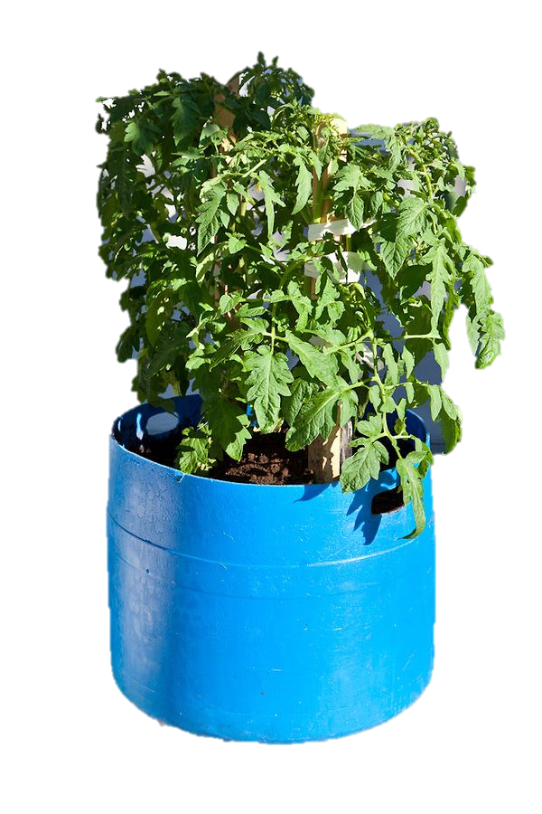
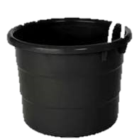
DIY Containers

Slide 18
Estimated Cost
 | $ | $$ | $$$
Wooden Container | $15 | $25 | $70
Ceramic Container | $7 | $25 | $30
Self-watering Container | $11 | $54 | $140

Slide 19
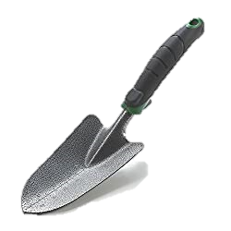
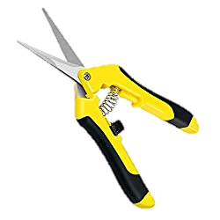
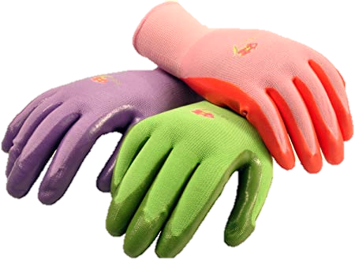
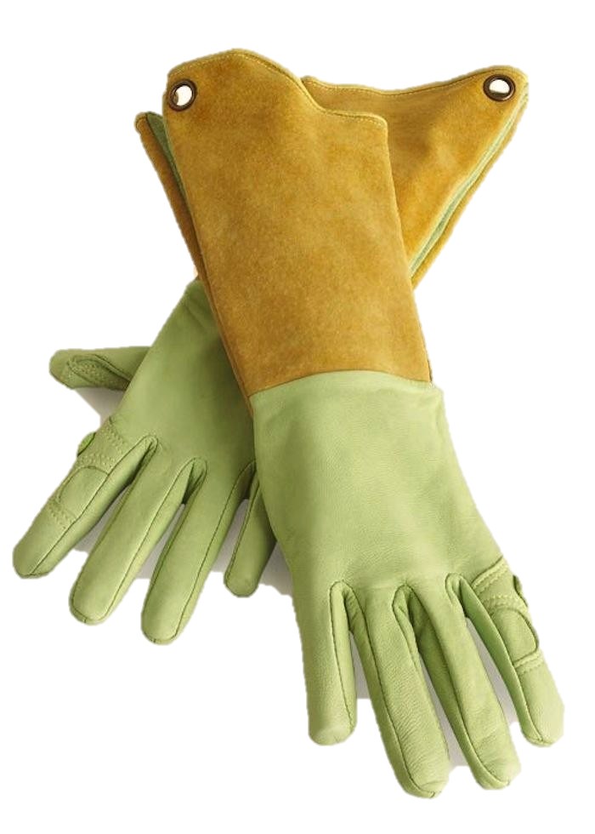
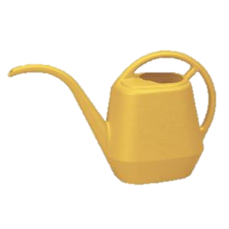
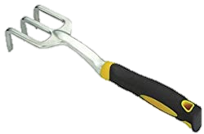
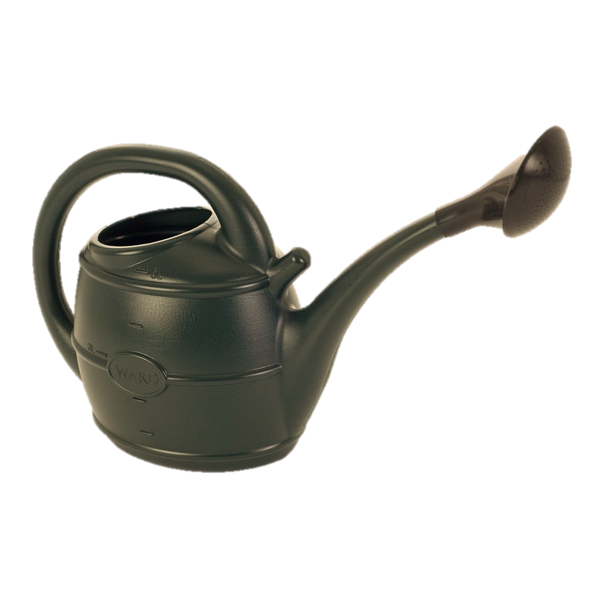
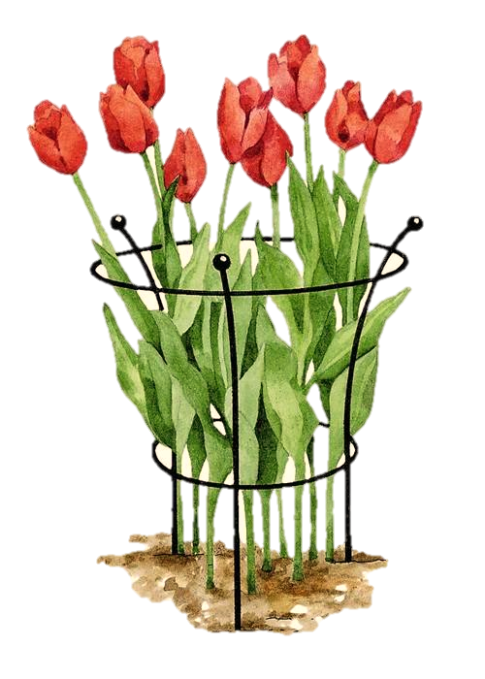
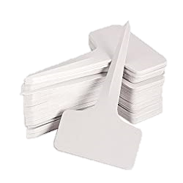
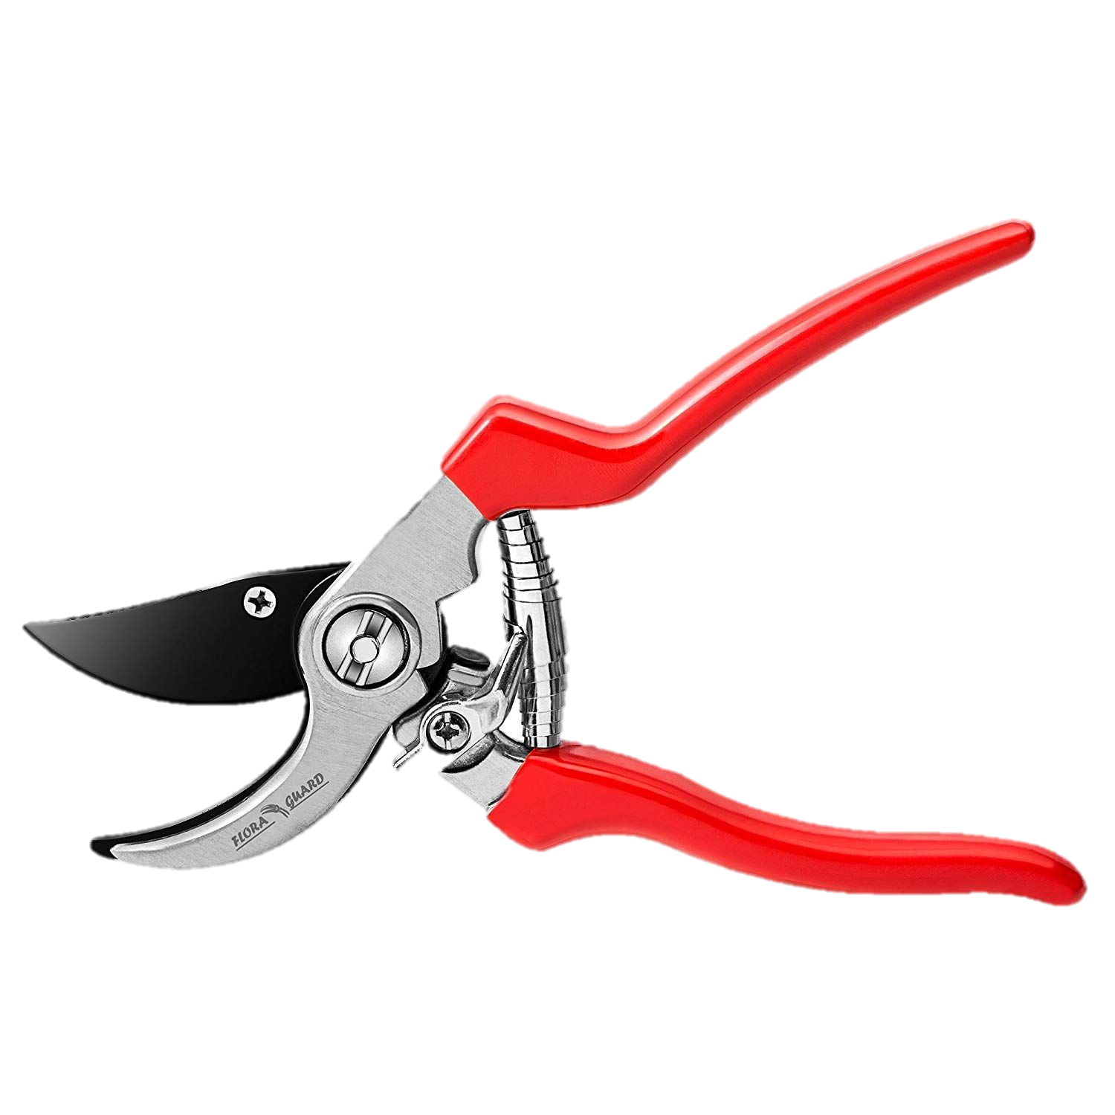
TOOLS
Hand Shovel
Garden Gloves
Micro-tip Scissors
Hand Cultivator
Watering Can
Plant Support
Pruner
Kneeling Pad
Plant Labels

Slide 20
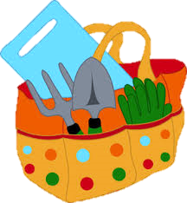
Hand Shovel: Carbon Steel, Iron, Steel
Hand Cultivator: Strong Metal
Pruner: Sharp Blades, Rust Resistant, locking mechanism
Gardening Gloves: Inexpensive bulk or one expensive pair
Watering Can: 1-3 gallons, long reach spout
Kneeling Pad: Flexible, water-proof, sponge-like/foam board.
Plant Support: Ties and twine
Plant Labels: Water-proof, long-lasting

Slide 21
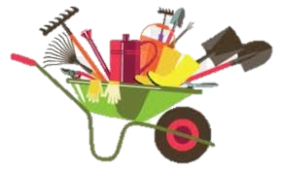
Tips
Clean hand tools after each use
Sanitize hand tools once a month with sanitizing wipes or soak in bleach for 10 minutes
Wipe scissors and pruner, occasionally.
Store tools where they will be protected from environmental elements
You can use an old outdoor throw pillow for a kneeling pad

Slide 22
Estimated Cost
 | $ | $$ | $$$
Hand Shovel | $5 | $10 | $25
Hand Cultivator | $11 | $20 | $30
Pruner | $4 | $10 | $50
Garden Gloves | $2 | $13 | $30
Watering Can | $7 | $15 | $35
Kneeling Pad | $4 | $11 | $20
Micro-tip Scissors | $9 | $16 | $26
Plant Support | $4 | $20 | $35
Plant Labels | $3 | $7 | $13

Slide 23
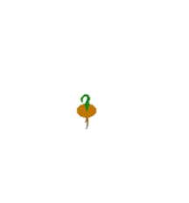
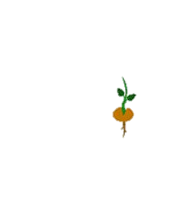
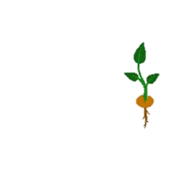
Seeds/Seedlings
Seeds are less expensive but can be unpredictable.
Seedlings are more expensive but have a higher survival rate.
If you started your seeds inside, you’ll have to harden off your seeds. Start by taking your container outside each, during calm weather, for an hour.

Slide 24
Advantages vs. Disadvantages
Advantages
Disadvantages
Great for gardeners with limited space
Grow all year around
Less weeding
Garden in urban areas
Save money on fresh produce
Recycle old containers
Reduces waste
Must watch soil moisture more closely
Must keep adding fertilizer throughout growing season
Root rot more likely to happen
Can be costly to start up

Slide 25
Over All Estimated Costs
 | $ | $$ | $$$
Potting Soil | $11 | $21 | $30
Fertilizer | $10 | $34 | $110
Container | $11 | $35 | $80
Tools | $49 | $122 | $264
Seeds/Seedlings | $1/$5 | $2/$9 | $3/$15
Total | $82/$86 | $214/$221 | $487/$499

Slide 26
Thank You!
QUESTIONS?

Slide 27
SBC AGRICULTURE DIVISION FUTURE
HORSEMANSHIP WORKSHOPS
GARDEN INTERNSHIP OPPORTUNITIES
CONTINUING EDUCATION UNITS
RANCH/FARMER STARTING PROGRAM
FARMER’S MARKET

Slide 28
Questions!
Can you use an old trash can for a container garden?
Why is it important to “harden off” your seedlings when transitioning them to the outdoors?
Why is fertilizer important for container gardens?
You shouldn’t use potting soil mix for your container garden. T F

